Slide 1
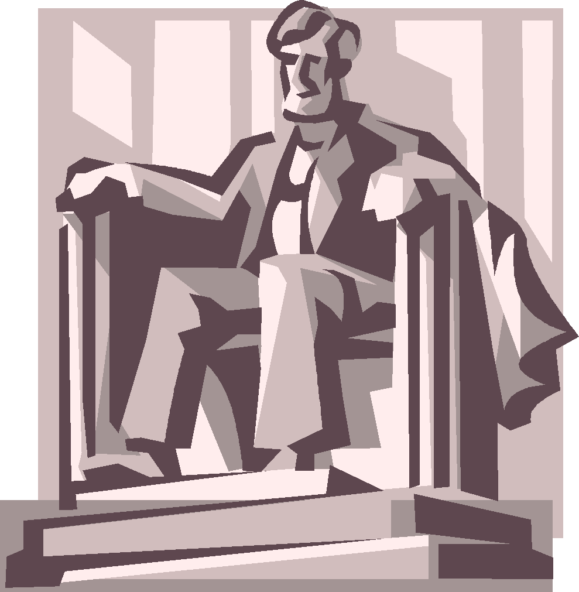
Washington, D.C.
March 12-13, 2020
5th Grade Class Field Trip
Stough Elementary School

Slide 2
Holbrook Field Trips
Education Field Trip Specialist since 1974
Founded by and directed by NC educators
230 NC schools traveled with Holbrook in 2017

Slide 3
Transportation to D.C.
Your group will travel by deluxe motorcoaches approved by Wake County Schools
Drivers are selected based on knowledge of the area and professionalism
Plush upholstered reclining seats
Comfortable headrests
LCD reading lights
Restroom equipped
DVD equipped
Adjustable foot rests

Slide 4
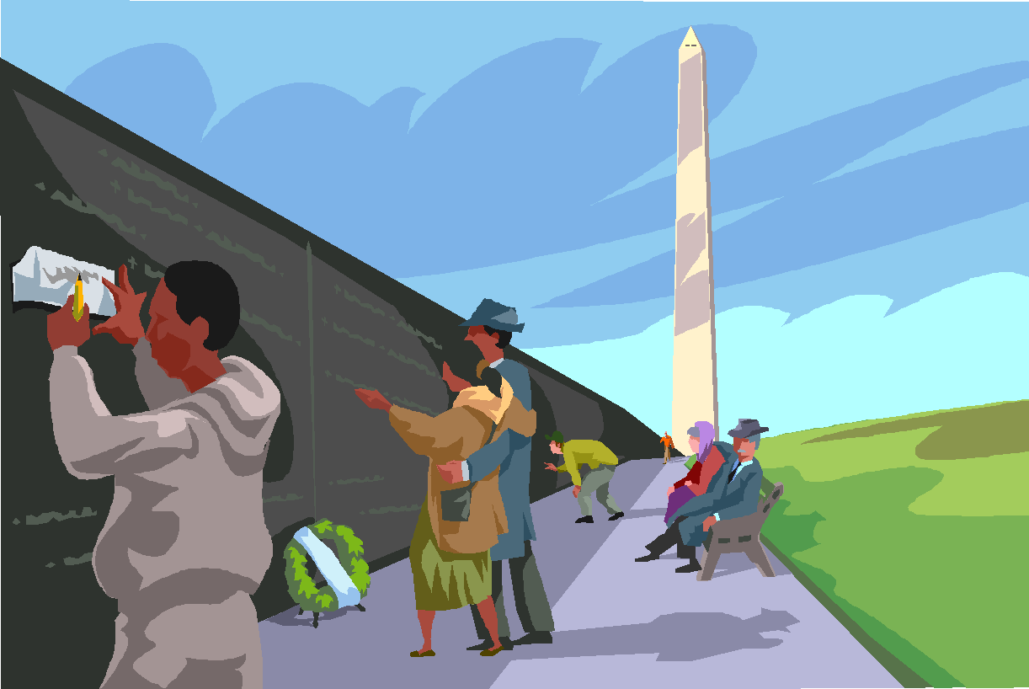
Itinerary- Day 1
Boarding begins at 6:30 AM
Depart for DC at 7:00 AM
Rest and/or meal stops every two hours
Lunch at rest stop before Washington, DC
Arrive DC late morning

Slide 5
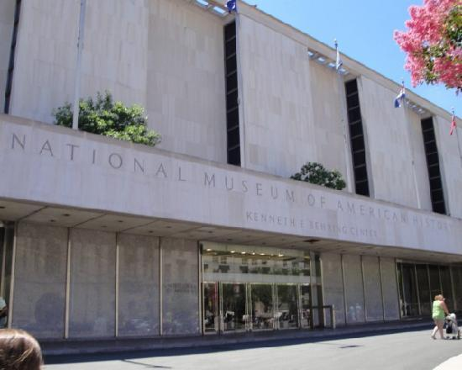
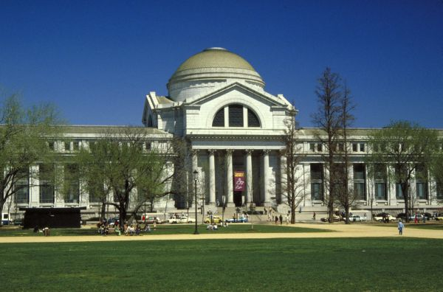
Smithsonian Museums
Museum of American History
Museum of Natural History
** Self-guided Visit**

Slide 6
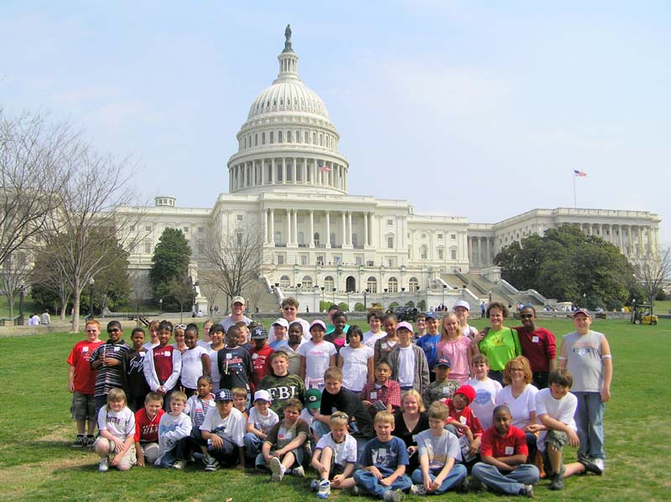
Guided Tour of the U.S. Capitol

Slide 7
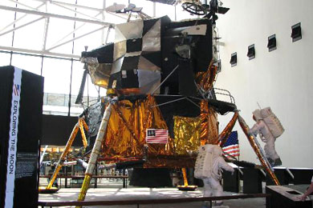
Smithsonian Museums
Air and Space Museum **Self-guided Visit**

Slide 8
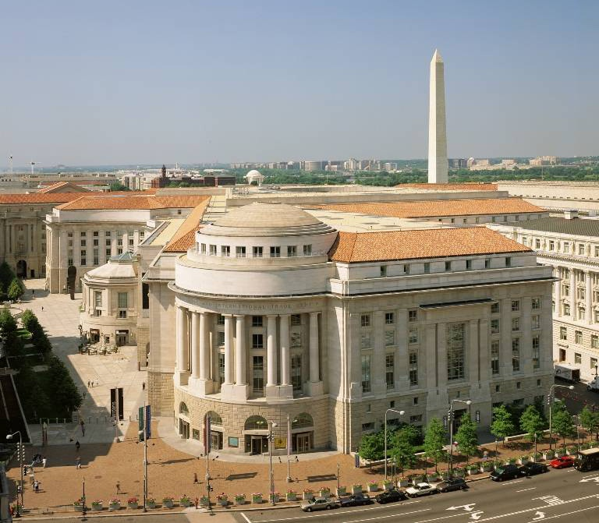
Dinner at Reagan International Trade Center Food Courts

Slide 9
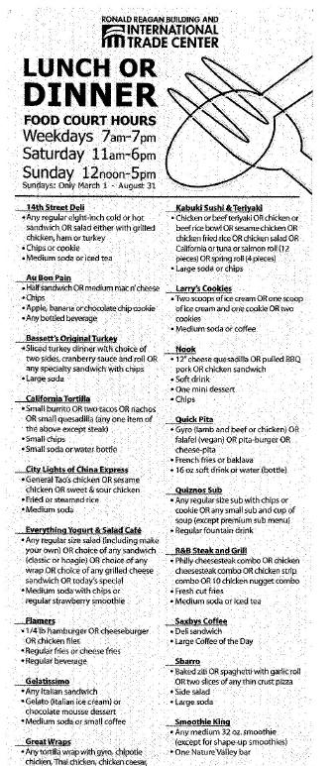
What is a voucher?
Vouchers are prepaid meal coupons to be used at restaurants in this food court
Vouchers offer students and parents a variety of restaurants
Helps students decide what choices to make for meals at each restaurant
Instead of using cash, the vouchers are redeemed at the restaurant to pay for the meal
Can be used at one location at a time
Offers many choices to account for allergies and likes/dislikes

Slide 10
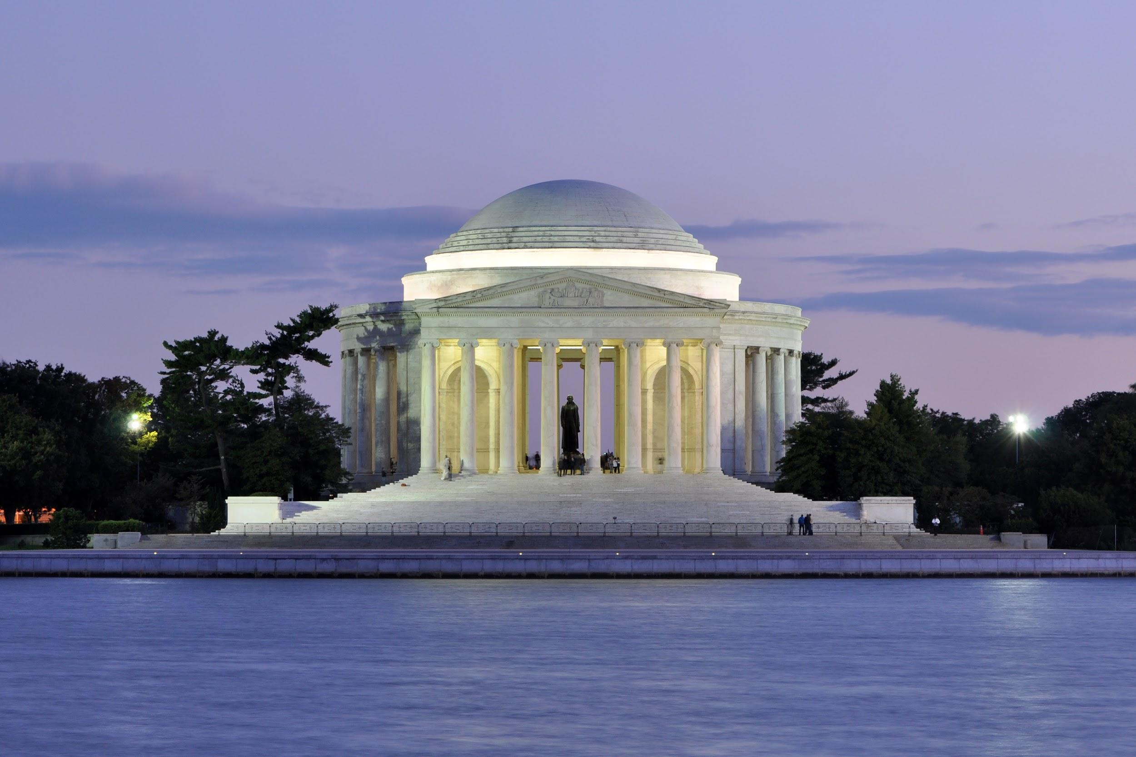
Visit the MLK and Jefferson Memorials

Slide 11
Is the hotel secure?
Hotel will be interior corridor rooms
It will be late evening by the time we return to the hotel.
Students return to their assigned rooms and may not leave to visit any other room or part of the hotel.
Comfort Inn Joint Base, Clinton MD

Slide 12
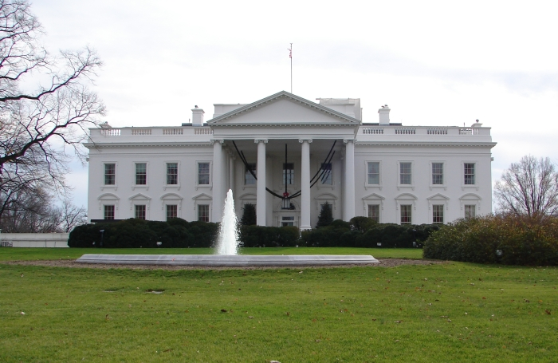
Photo stop at The White House
8:15am Friday morning

Slide 13
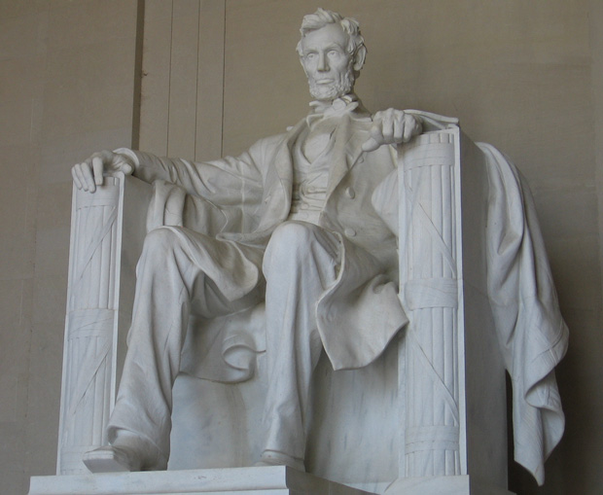
Visit the Lincoln, Vietnam Veterans, and Korean War Memorials

Slide 14
Drive by the World War II Memorial

Slide 15
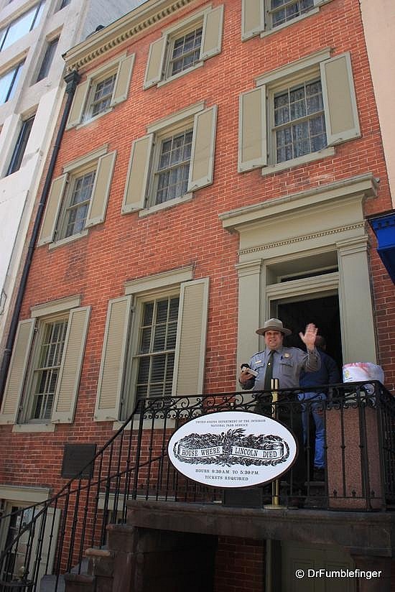
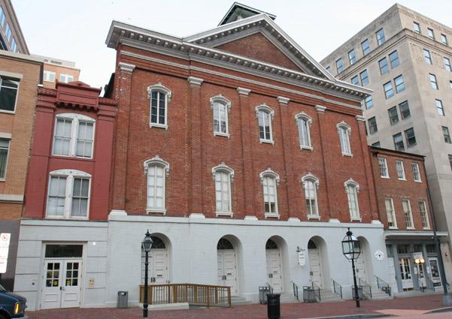
Visit Ford’s Theatre and Petersen House Area 11:00am Friday

Slide 16
Gourmet boxed lunches are included. We will be eating on the National Mall by the Washington Monument.

Slide 17
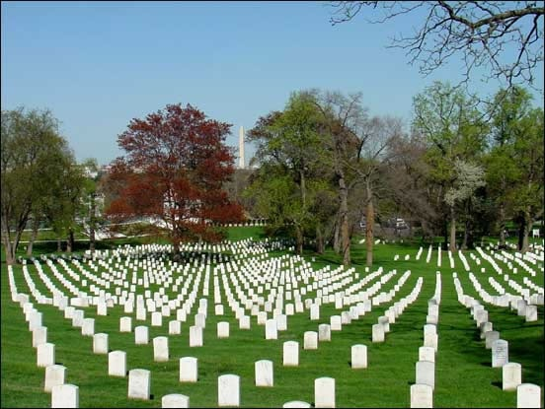
Guided Walking Tour of Arlington National Cemetery

Slide 18
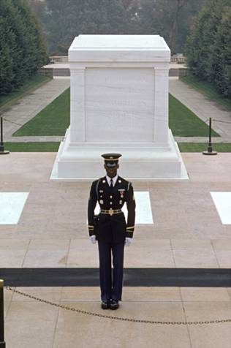
Changing of the Guard at the Tomb of the Unknown Soldiers

Slide 19
Gravesites of President JF Kennedy & family

Slide 20
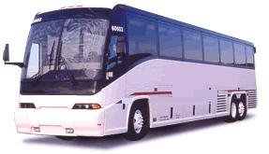
Depart D.C. early afternoon
Fast food dinner stop ($10 cash included)
Rest and/or meal stops every two hours
Arrive at school approximately 10:00 PM

Slide 21
Included in the trip
Hotel accommodations for one evening
Charter bus transportation
One hot continental breakfast at hotel
Two dinners and one lunch
Attractions and fees, & gratuities for bus drivers
Professional Full-Time Tour Director
Additional guides for tours of memorials

Slide 22
Bus Guidelines
Stay seated
Earphones must be used
Snacks from home
Plastic bottles with caps
Keep it clean
NO GUM
DO NOT bring drinks with lids that don’t seal
NO aerosols or items that are not allowed at school
NO loud or distracting noises

Slide 23
Pack 1 small suitcase & a small carry-on for the bus ride
Bring
Comfortable sneakers and an extra pair in case of wet weather
Jacket
A small umbrella and rain jacket
School appropriate clothes
Bag lunch for Day 1
Snacks
Money for souvenirs
Camera
Portable phone charger
Don’t Bring
Flip flops
Baggy pants
Clothes against school dress code
Anything that can be considered a weapon
You may be subject to search when entering the museums and buildings
Gum
Expensive items

Slide 24
Have a great time!!
Thank you parents for supporting this adventure in learning.
We are proud to be taking this group of students to see our nation’s capitol first hand.
This trip is not possible without parent chaperones!

Slide 25
Works Cited
Smithsonian National Air and Space Museum National Mall Building
Photo © Eric Long/OIPP, National Air and Space Museum, Smithsonian Institution
Smithsonian National Museum of Natural History. Photo © Smithsonian Institution
Aerial View of the National Mall in Washington, DC. Photo courtesy of the National
Park Service
Korean War Memorial - Aeriel View. Photo © Terry J. Adams, National Park Service
Washington Monument. Photo © Rachel Cooper, licensed to About.com, Inc.
The U. S. Capitol Building. Photo © Rachel Cooper, licensed to About.com, Inc.
Latoff, Richard. American Battle Monuments Commission.
WWII Memorial View from Washington Monument

